Slide 1
Lecture – 01
Approximation Algorithms

Slide 2
Overview
Introduction
Performance ratios
Traveling salesman problem
The vertex-cover problem
Set cover problem
Approximation Algorithms

Slide 3
Introduction
There are many important NP-Complete problems
  There is no fast solution !
But we want the answer …
  If the input is small use backtrack.
  Isolate the problem into P-problems !
  Find the Near-Optimal solution in polynomial time.
Approximation Algorithms

Slide 4
Performance ratios
We are going to find a Near-Optimal solution for a given problem.
We assume two hypothesis :
  Each potential solution has a positive cost.
  The problem may be either a maximization or a minimization problem on the cost.
Approximation Algorithms

Slide 5
Performance ratios …
If for any input of size n, the cost C of the solution produced by the algorithm is within a factor of ρ(n) of the cost C* of an optimal solution:
Max ( C/C* , C*/C ) ≤ ρ(n)
We call this algorithm as an ρ(n)-approximation algorithm.
Approximation Algorithms

Slide 6
Performance ratios …
In Maximization problems:
0<C≤C* , ρ(n) = C*/C
In Minimization Problems:
0<C*≤C , ρ(n) = C/C*
  ρ(n) is never less than 1.
  A 1-approximation algorithm is the optimal solution.
  The goal is to find a polynomial-time approximation algorithm with small constant approximation ratios.
Approximation Algorithms

Slide 7
Some examples:
Traveling salesman problem.
Vertex cover problem.
Set cover problem.
Approximation Algorithms

Slide 8
Traveling salesman problem
Given an undirected weighted Graph G we are to find a minimum cost Hamiltonian cycle.
Satisfying triangle inequality or not this problem is NP-Complete.
    We can solve Hamiltonian path.
Approximation Algorithms

Slide 9
Traveling salesman problem
Near Optimal solution
  Faster
  More easy to impliment.
Approximation Algorithms

Slide 10
Traveling salesman problem with triangle inequality.
APPROX-TSP-TOUR(G, c)
1 select a vertex r Є V[G] to be root.
2 compute a MST for G from root r using Prim Alg.
3 L=list of vertices in preorder walk of that MST.
4 return the Hamiltonian cycle H in the order L.
Approximation Algorithms

Slide 11
Traveling salesman problem with triangle inequality.
MST
root
Pre-Order walk
Hamiltonian Cycle
Approximation Algorithms

Slide 12
Traveling salesman problem
This is polynomial-time 2-approximation algorithm. (Why?)
  Because:
    APPROX-TSP-TOUR is O(V²)
    C(MST) ≤ C(H*)
    C(W)=2C(MST)
    C(W)≤2C(H*)
    C(H)≤C(W)
    C(H)≤2C(H*)
Optimal
Pre-order
Solution
Approximation Algorithms

Slide 13
Some examples:
Traveling salesman problem.
Vertex cover problem.
Set cover problem.
Approximation Algorithms

Slide 14
The vertex-cover problem
A vertex-cover of an undirected graph G is a subset of its vertices such that it includes at least one end of each edge.
The problem is to find minimum size of vertex-cover of the given graph.
This problem is an NP-Complete problem.
Approximation Algorithms

Slide 15
The vertex-cover problem …
Finding the optimal solution is hard (its NP!) but finding a near-optimal solution is easy.
There is an 2-approximation algorithm:
  It returns a vertex-cover not more than twice of the size optimal solution.
Approximation Algorithms

Slide 16
The vertex-cover problem …
APPROX-VERTEX-COVER(G)
1 C ← Ø
2 E′ ← E[G]
3 while E′ ≠ Ø
4 do let (u, v) be an arbitrary edge of E′
5 C ← C U {u, v}
6 remove every edge in E′ incident on u or v
7 return C
Approximation Algorithms

Slide 17
The vertex-cover problem …
Near Optimal
size=6
Optimal
Size=3
Approximation Algorithms

Slide 18
The vertex-cover problem …
This is a polynomial-time
2-aproximation algorithm. (Why?)
  Because:
    APPROX-VERTEX-COVER is O(V+E)
    |C*| ≥ |A|
    |C| = 2|A|
    |C| ≤ 2|C*|
Selected Edges
Optimal
Selected Vertices
Approximation Algorithms
Notes:
Approximation Algorithmes

Slide 19
Some examples:
Traveling salesman problem.
Vertex cover problem.
Set cover problem.
Approximation Algorithms

Slide 20
The set-Cover
Generalization of vertex-cover problem.
We have given (X,F) :
  X : a finite set of elements.
  F : family of subsets of X such that every element of X belongs to at least one subset in F.
  Solution C : subset of F that Includes all the members of X.
Approximation Algorithms

Slide 21
The set-Cover …
Minimal Covering set
size=3
Approximation Algorithms

Slide 22
The set-Cover …
GREEDY-SET-COVER(X,F)
1 M ← X
2 C ← Ø
3 while M ≠ Ø do
4 select an SЄF that maximizes |S ∩M|
5 M ← M – S
6 C ← C ∪ {S}
7 return C
Approximation Algorithms

Slide 23
The set-Cover …
1st chose
3rd chose
2nd chose
Greedy
Covering set
size=4
4th chose
Approximation Algorithms

Slide 24
The set-Cover …
This greedy algorithm is polynomial-time ρ(n)-approximation algorithm
  ρ(n)=H(max{|S| : S Є F})
Approximation Algorithms

Slide 25
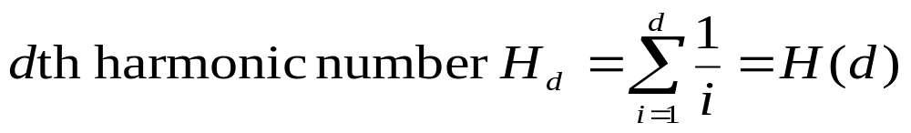



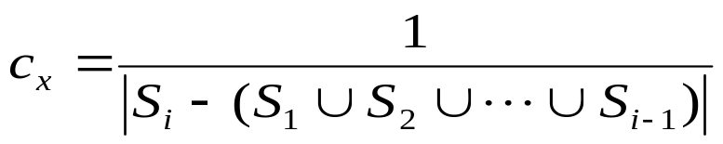
Set Cover
Theorem: GREEDY-SET-COVER is a
polynomial-time ρ(n)-approximation algorithm for
Proof:
Algorithm runs in time polynomial in n.
paid only when x is covered for the first time
assume x is covered for the first time by S_{i}
(spread cost evenly across all elements covered for first time by S_{i} )
Number of elements covered for first time by S_{i}
Approximation Algorithms

Slide 26
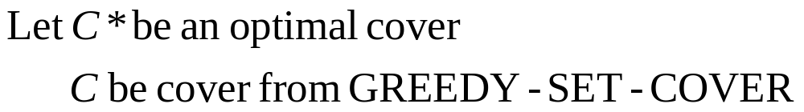
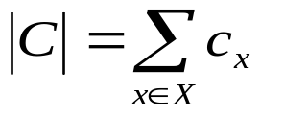
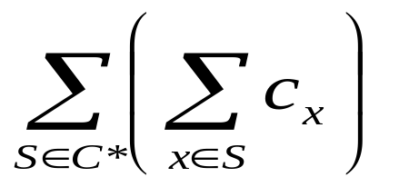
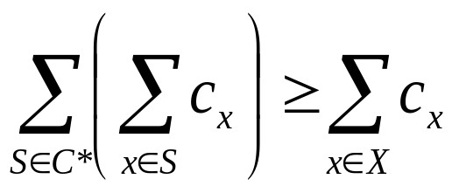
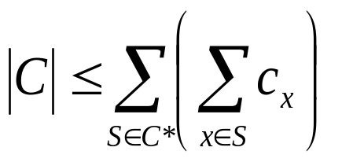
Set Cover (proof continued)
Theorem: GREEDY-SET-COVER is a
polynomial-time ρ(n)-approximation algorithm for
Proof: (continued)
1 unit is charged at each stage of algorithm
Cost assigned to optimal cover:
Each x is in >= 1 S in C*
Approximation Algorithms

Slide 27
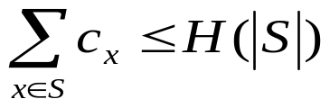
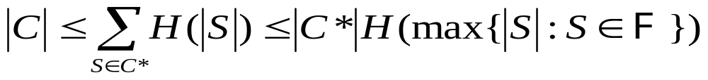
Set Cover (proof continued)
Theorem: GREEDY-SET-COVER is a
polynomial-time ρ(n)-approximation algorithm for
Proof: (continued)
How does this relate to harmonic numbers??
We’ll show that:
For any set S
And then conclude that:
which will finish the proof
Approximation Algorithms

Slide 28


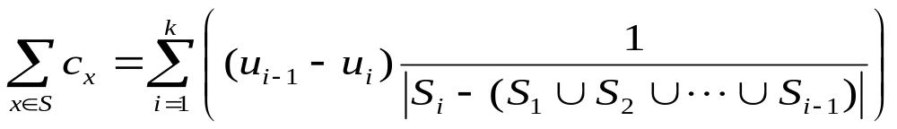
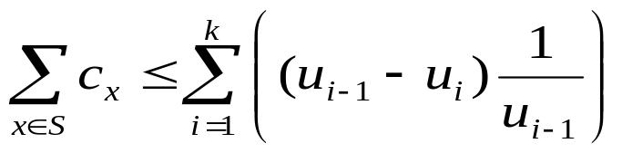
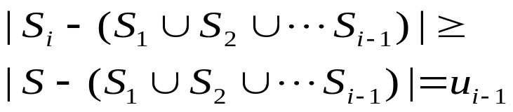
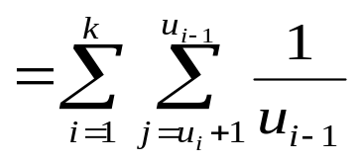
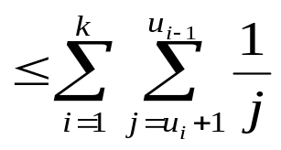
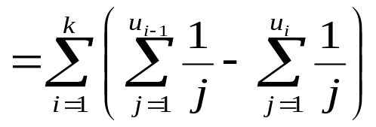
Set Cover (proof continued)
Proof of:
For some set S: Number of elements of S remaining uncovered after S₁…S_{i} selected
k = least index for which u_{k}=0.
Since, due to greedy nature of algorithm:
since j <= u_{i-1}
telescoping sum
Approximation Algorithms

